Slide 1
Environment Monitoring
Team Members:
Bala U
Sathish S
Gowtham M
Veeramani M

Slide 2

‘Environment Monitoring’ project employs sensor to track moisture, air quality, noise, temperature, and humidity, providing vital environmental insights for sustainability.
Introduction

Slide 3
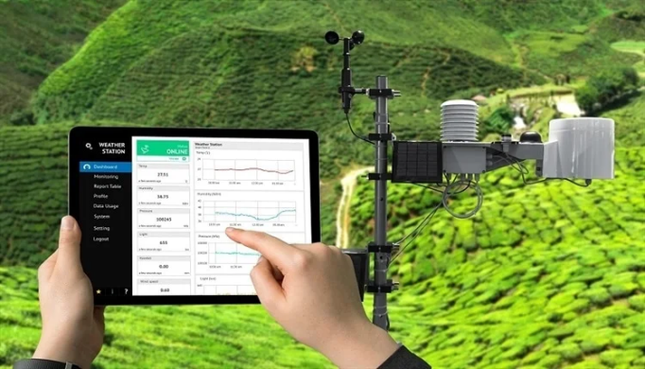
Our project employs specialized sensors and data loggers to continuously collect moisture, air quality, noise, temperature, and humidity from strategically placed locations.
Methodology
This data is wirelessly transmitted to a central database for real time analysis, providing precise environmental monitoring.

Slide 4
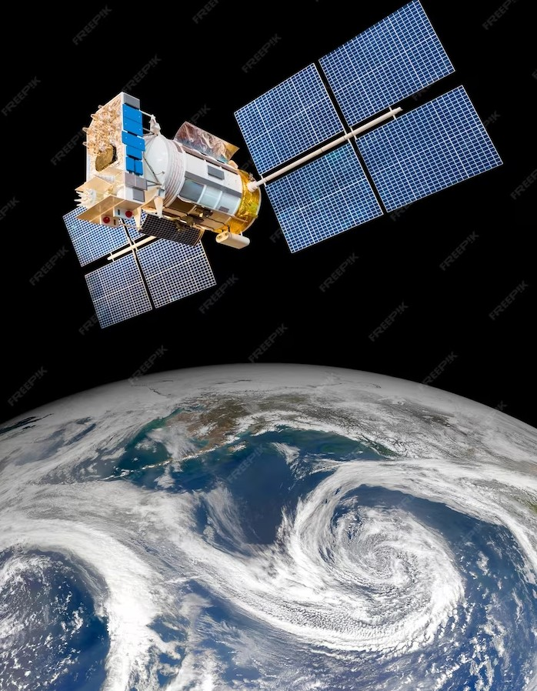
Data and Findings
Our data highlights moisture variation, air quality trends, noise fluctuations, and precise temperature/humidity data, enabling informed environmental decisions for sustainability.

Slide 5

Application & Conclusion
The applications of our ‘Environment Monitoring’ project span from optimizing agriculture practices to enhancing urban planning, demonstrating its versatility in addressing environmental challenges.
Our project’s findings and real-world applications underscore its importance as a tool for informed decision-making and a step towards a more sustainable future.

Slide 6

Thanks!

